Slide 1
PROGRAMMING PARADIGMS CS403

Slide 2
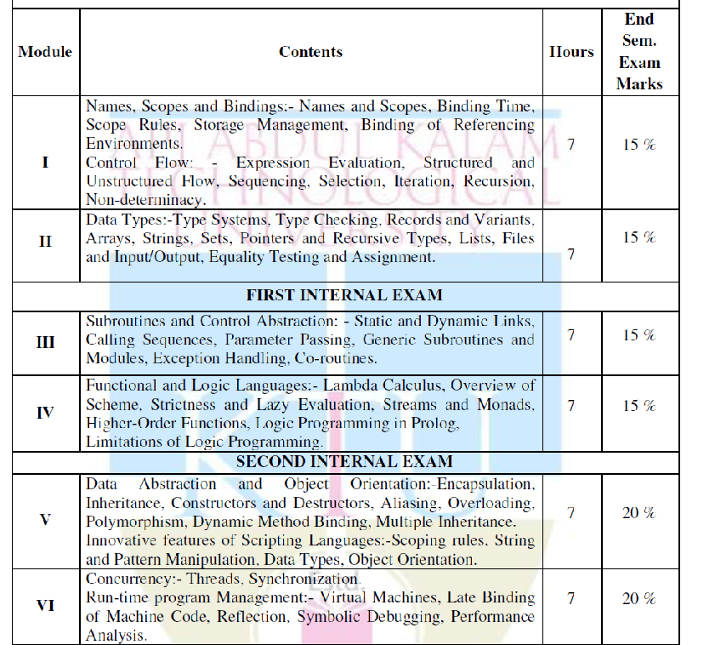

Slide 3
Module 1
Names, Scopes and Bindings

Slide 4
Name
Name is a mnemonic character string representing something
Names and identifiers(alphanumeric tokens)
Names refer to variables, constants, operations, types etc.
Names refer to abstraction
Programmer associates name with complicated program fragment
Subroutines are control abstractions
Allow programmer to hide complicated code in a simple interface
Class-> data abstractions
Allow programmer to hide data representation behind a set of operations

Slide 5
Binding Time
Binding time
Binding of name to thing it represents
Used to resolve design decision in language implementation
Referencing Environment
Complete set of bindings at a given point in a program

Slide 6
Notion of Binding Time
Binding- association between 2 things
Binding time
Time at which binding is created
Time at which implementation decision is made
Different times at which decisions bounded:
Language design time
Control flow constructs, primitive types, constructors etc. are chosen
Language implementation time
Number of bits of primitive types, coupling of I/O to files, size of stack & heap, handling of run-time exception

Slide 7
Program writing time
Programmers choose algorithms, data structures and names
Compile Time
Mapping of high level constructs to machine code
Link time
Most compilers support separate compilation
Compiling different modules of program at different times
Load time
Time at which OS loads program into memory
Run Time
Entire span from beginning to end of execution

Slide 8
Object Lifetime
Bindings lifetime
Time between creation and destruction of name-to-object binding
Objects lifetime
Time between creation and destruction of object
Dangling Reference
Binding to object that no longer live

Slide 9
Storage Management
Static
Given absolute address retained throughout program execution
Stack
Allocated and deallocated in LIFO order
Applicable for subroutines- subroutine call and return
Heap
Allocated and deallocated at arbitrary times

Slide 10
Static Allocation
Objects whose value should not change during program execution
Statically allocated objects:
Global variables
Instruction for machine language translation
Local variables that retain values between invocation
Numeric and string-valued constant literals
A=B/14.7
printf("Hello world")
Tables used by run time routines
Debugging, dynamic-type checking, garbage collection, exception handling

Slide 11
Named Constants
Value is determined at compile time
Private Const votingAge As Integer=18

Slide 12
Compile Time
Syntax Checking
Elaboration time
Translation of HLL to LLL
Run Time
Execution of LLL

Slide 13
Elaboration time Constants
C, Ada
Values may depend on other values not known until runtime
Elaboration Time Constants local to recursive subroutine must be allocated on stack
C# provides both options
Keywords: const and readonly

Slide 14
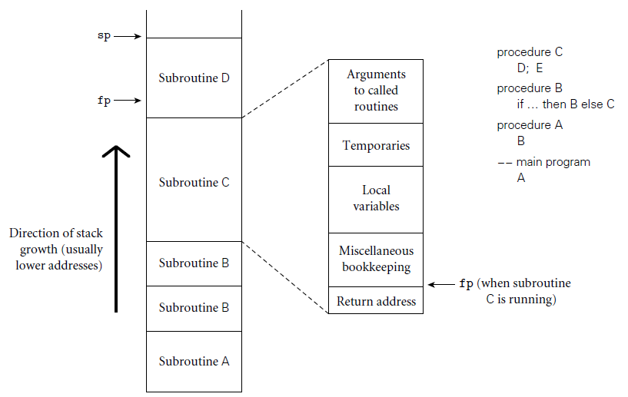
Stack based Allocation
For recursive static allocation not possible
Number of instants of a variable is unbounded
Stack allocation is a solution

Slide 15
Each instance of a subroutine at runtime has a frame on stack called activation record
Arguments
Return Values
Local Variables
Temporaries
Bookkeeping information
Maintenance of stack is done by subroutine calling sequence, prologue and epilogue

Slide 16
Calling Sequence
Code executed by caller immediately before and after call
Combined operations of caller, prologue and epilogue
Prologue
Code executed at the beginning
Epilogue
Code executed at the end

Slide 17
Heap-Based Allocation
Used for the dynamically allocated objects
Strings, lists, and sets, whose size may change as a result of an assignment statement or other update operation.
Space concern issues
Internal fragmentation
Allocates a block larger than required to hold a given object
External fragmentation
Blocks assigned to objects are scattered in heap
Remaining unused space cannot process future request
Storage management maintains a list of free blocks in heap- free list
Initially list has entire heap

Slide 18
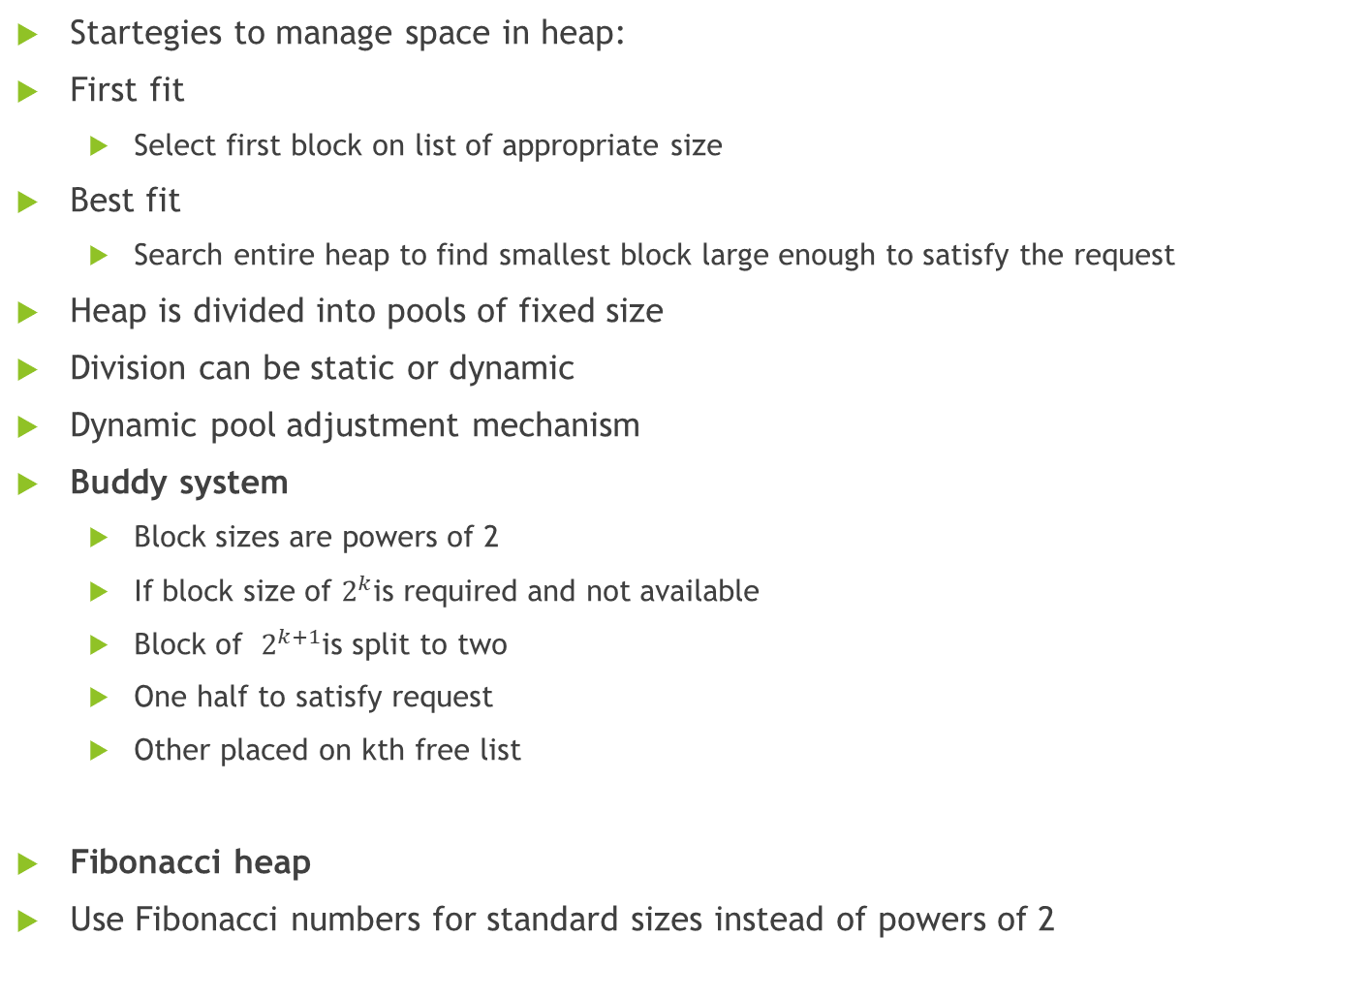
Startegies to manage space in heap:
First fit
Select first block on list of appropriate size
Best fit
Search entire heap to find smallest block large enough to satisfy the request
Heap is divided into pools of fixed size
Division can be static or dynamic
Dynamic pool adjustment mechanism
Buddy system
Block sizes are powers of 2
If block size of $2^{k}$is required and not available
Block of $2^{k+1}$is split to two
One half to satisfy request
Other placed on kth free list
Fibonacci heap
Use Fibonacci numbers for standard sizes instead of powers of 2

Slide 19
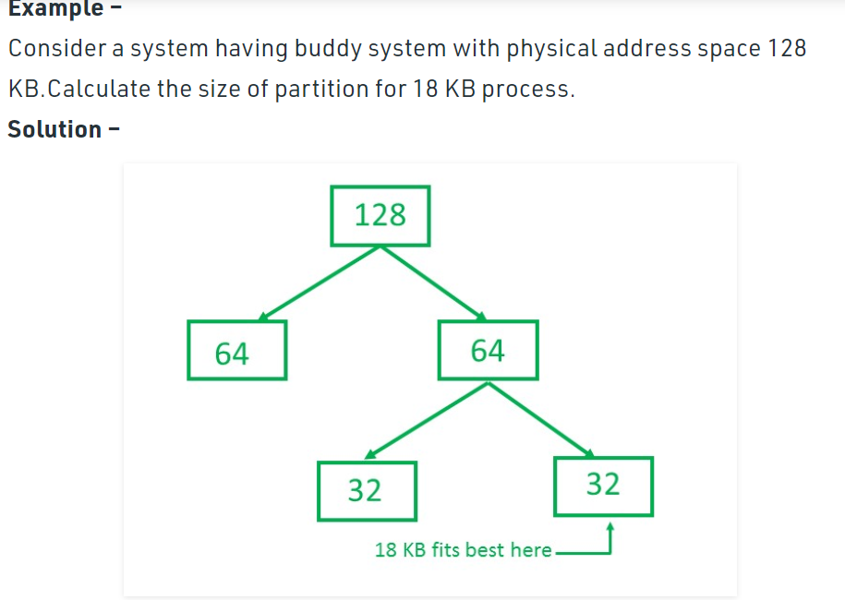
Buddy System
So, size of partition for 18 KB process = 32 KB. It divides by 2, till possible to get minimum block to fit 18 KB.

Slide 20
https://www.geeksforgeeks.org/operating-system-allocating-kernel-memory-buddy-system-slab-system/

Slide 21
Garbage Collection
Garbage collection mechanism identifies and reclaims unreachable objects
Modula 3, Java, C#
Automated Process
Manual deallocating leads to costly bugs
If object is deallocated soon
Results in dangling reference
Accessing memory used by another object
If the object is not deallocated at the end of its lifetime
Results in memory leak
Running out of heap space

Slide 22
Scope Rules
Textual region of program where binding is active
Determined statically or dynamically
Modern Languages- static binding
Binding determined at compile time
C language
Dynamically Scoped
Bindings depend on flow of execution at runtimeAPL,Snobol,early dialects of Lisp

Slide 23
Referencing Environment
Set of active bindings at any given point in a programs execution
Sequence of scopes examined to find the current binding for a given name
Determined by static or dynamic scope rules
Also depends on referencing rules
Deep Binding
Binds the environment at the time a procedure is passed as an argument
Takes the environment of the parent function
Shallow Binding
Binds the environment at the time a procedure is actually called
Takes the environment of the 'final' calling function

Slide 24
Static Scoping
Scope is determined at compile time by examining the text of the program
Basic language -simple scope rules
There is only a single global scope
Few hundred possible names
Variables are declared by the virtue of its use
Fortran
Distinguished between local and global variables
Scope of local variable is limited to its subroutine
Variable declarations optional
If not declared assumes local scope and Integer if name starts with I-N
Or real otherwise

Slide 25
Global variables partitioned into common blocks
Local variable scope is limited to single execution of variables subroutine
This can be overridden using save statement
Saved variable lifetime is entire program
C- Static
Algol- own

Slide 26
Static Scope Rule
The current binding for a name is found in the matching declaration whose block most closely surrounds a given point in the program

Slide 27
Static Scoping
Nested Subroutines
Access to nonlocal objects
Declaration Order
Declarations and Definitions
Nested Blocks
Modules
Encapsulating data and subroutines
Modules as abstractions
Imports and Exports
Modules as Managers

Slide 28
Module Types and Classes
Object Orientation
Modules containing classes
Dynamic Scoping

